Slide 1
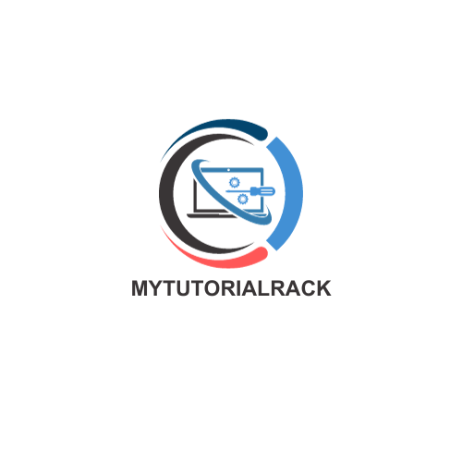

Salesforce Admin Certification Course
Mytutorialrack.com
Notes:
Create a new copy of the same sides and just change the first slide with the name “Salesforce Admin Certification Course”

Slide 2
Create a Free Developer Account

Slide 3
Connect with me
Join me on Facebook
Join me on LinkedIn
Checkout my website

Slide 4
Navigating Inside of Salesforce Lightning UI
Applications
Tabs
Object and its Fields
Profiles
User

Slide 5
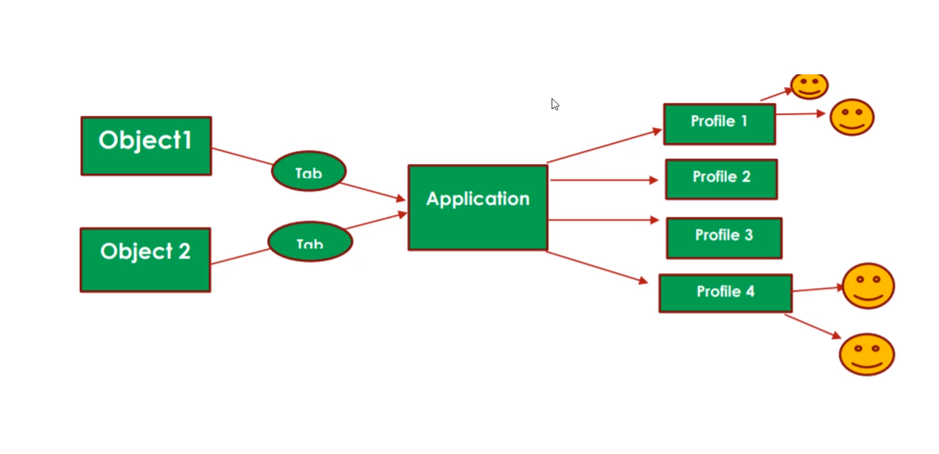

Slide 6
What are objects and fields in Salesforce?
Name | Email Id | Address | Date of Birth | Salary
John Smith | john@yahoo.com | Dallas, TX | July 14, 1975 | 150K
Samantha Bee | BeeSam@gmail.com | Delhi, India | August 17,1980 | 140K
Angelina Jolie | Ang_jolie@gmail.com | Frisco, TX | May 12, 1980 | 130K
Table in Excel Sheet is called as Object in Salesforce.
Column of table is called as Fields in Salesforce.
Row of the table is called as Record in Salesforce.

Slide 7
Types of Objects in Salesforce :
Standard Object
Custom Object

Slide 8
Standard Objects
Standard Objects are provided by Salesforce as a basic CRM structure. These include account, contact, opportunity, lead, campaign and so on.
These are the tables that contain the records in any standard tabs, such as Accounts, Contacts, Opportunities, Leads, Campaigns, and so on.

Slide 9
Custom Object
In addition to standard objects, Salesforce allows you to create custom objects to store data specific to your organization, which is not doable through standard objects.
For example, creating a custom object to store employee checking, patient information.
Custom objects are usually identified by a __c suffix.

Slide 10
Difference between Standard and Custom Object:
Standard Object | Custom Object
Can’t delete | Can delete
Can’t Change the Grant Access Using Hierarchies sharing access | Can Change the Grant Access Using Hierarchies sharing access
We can’t Truncate standard objects | It is possible to truncate custom objects.
It is possible to create custom fields on standard objects | Custom objects contain some standard field, for example, Name, Created by, Last Modified by and so on.

Slide 11
Standard fields
Standard fields are predefined fields that are included as standard within the salesforce application.
Standard fields cannot be deleted, but non-required standard fields can be removed from page layouts whenever needed.
Both Standard and custom objects contain a few common standard fields, for example, Name, Created Date, Last Modified Date, and Owner fields.

Slide 12
Standard fields for custom objects
Field Name | Description
CreatedById | ID of the user who created the record.
Currency | Currency of the record if multicurrency is enabled.
Division | Division to which the custom object record belongs. Available only in organizations that use divisions to segment their data.
LastModifiedById | ID of the user who most recently changed the record.
Name | Identifier for the custom object record.
OwnerId | ID of the assigned owner of the custom object record.

Slide 13
Custom fields
Custom fields are unique to your business needs and not only can they be added and amended, but also deleted.
Creating custom fields allows you to store the information that is necessary for your organization.
Both standard and custom fields can be customized to include custom help text, which helps users understand how to use the fields. Custom fields are usually identified by a __c suffix.

Slide 14
Build our Recruiting Application
Position
Job Application
Candidate object
Job Posting
Review object
Employment
Web Site

Slide 15
Create our Custom app

Slide 16
Position object and its fields
Field Name | Data Type
Open Date | Date
Hire By | Date
Close Date | Date
Location | Picklist ( San Francisco, CA, NewYork, NY, Tokyo, Japan, Mumbai, India )

Slide 17
Position object and its fields
Field Name | Data Type
Job Responsibilities | Text Area Long
Skills Required | Multi-Select Java C# JavaScript Salesforce Apex
Travel Required | Checkbox
Min Pay | Currency
Max Pay | Currency
Type | Full-time Part-time

Slide 18
Candidate Object and its fields
Field Name | Data Type
First Name | Text (50)
Last Name | Text (50)
Phone | Phone
Email | Email
Street | Text (50)
City | Text (50)
State | Text (50)
Postal Code | Text (15)
Country | Text (20)
Years of Experience | Number (2)

Slide 19
Candidate Object and its fields
Field Name | Data Type
SSN | Encrypted
Education | Picklist ( HS Diploma BA /BS MA/MS/MBA Ph.D. Post Doc )
Are you currently Employed? | Checkbox
Are you US citizen? | Checkbox
Do you need visa? | Checkbox

Slide 20
Validation Rules
Validation Rules verify that data entered by users in records meets the standard you specify before they can save it.
A validation rule ca contain a formula or expression that evaluates the data in one or more fields and returns a value of “True” or “False”
When the validation rule returns a value of “True”, this confirms that the data entered by the user contains an invalid value.
Validation rules can also include error messages to display to users when they enter invalid values based on specified criteria.
Using these rules effectively contributes to quality data.
For example, you can ensure that all phone number fields contain a specified format or that discounts applied to certain products never exceed a defined percentage.

Slide 21
Creating Validation Rules
Min Pay cannot be greater than Max Pay
If the Position status is closed, then Close Date is required.
Closed Date should always be after Open Date.
Max Pay cannot be more than 1M.
If the Candidate is US citizen, then Visa Required should be unchecked and Vice versa.

Slide 22
Formula Fields
Salesforce Formula Field is a read-only field that derives its value from a formula expression you define.
The formula field is updated when any of the source fields change.
Sometimes we need to change the value based on the other source field value then we need a formula field.
Formula field is a read-only field.

Slide 23
Create some Formula Fields
Calculate Number of Days, position is opened for.
Show a Green Checkbox if the status of the Position is New and Show red image if the status of the position is Closed.
Show the Candidate Full Name (First Name Last Name)
Ask the user to enter his twitter Handle and then create a field to show a Dynamic link to his twitter handle.

Slide 24
Formula Fields
Formula fields have a text size limit of 3,900 characters and a compilation limit of 5,000 characters and when these limits are reached, you cannot save the formula field.

Slide 25
Limitations:
How to find out, which candidates applied to which positions or vice versa?
Which positions candidate has applied to ?
How many candidates applied to a particular position ?

Slide 26
Solution 1: Create a single table
Creating a single object, which contains fields from both the objects.
Duplication of Date
Hard to Manage
No Reusability of the table
Position Title | Max Pay | Min Pay | First Name | Last Name | Address | Phone number | Email | Skills

Slide 27
Solution 2: Create Relationship b/w the objects
You can associate one object with another
Relationships are created by creating custom relationship fields on an object.
This is done so that when users view records, they can also see and access related data.
An example of a relationship between standard objects in Salesforce is the relationship between Account and Contacts.

Slide 28
Types of relationship
One to Many
Many to Many
Self- relationship

Slide 29
One to Many (Parent and Child)
One Hiring Manager can handle multiple positions at a time.
One Manager can have multiple employees under him/her, but one employee can not have multiple managers.
Manager
Position
One to Many(1:Many)
Manager
Employee
One to Many(1:Many)

Slide 30
Parent and Child in a relationship
One school has multiple students enrolled but one student can’t enroll in multiple schools at the same time.
There can be multiple job Applications for one position but through one Job Application, we cannot apply for multiple Positions.
Relationship field will always go on the Child Object.
School
Student
One to Many(1:M)
Position
(Parent)
Job Application
(Child)
One to Many(1:M)

Slide 31
One to Many (Parent and Child)
One Hiring Manager can handle multiple positions at a time.
One Manager can have multiple employees under him/her, but one employee can not have multiple managers.
Manager
Position
One to Many(1:Many)
Manager
Employee
One to Many(1:Many)

Slide 32
One to Many Relationship types
Lookup Relationship
Master-Detail Relationship

Slide 33
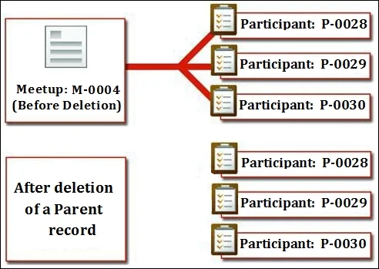
Lookup Relationship
Its is a loosely coupled relationship among Salesforce object, which means even if a parent record gets deleted, the child records remain in the system.
Here, both the parent and child have their own sharing settings and security controls.

Slide 34
Create a Hiring Manager Field on the Position Object (Lookup)
Manager
(User)
Position
(Child)
1:M(One to Many)

Slide 35
Job Application

Slide 36
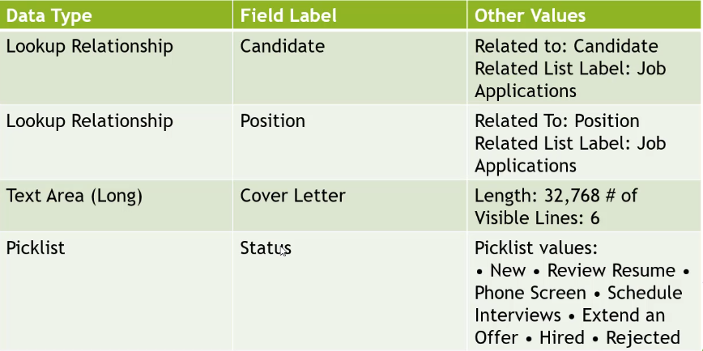
Job Application Object

Slide 37
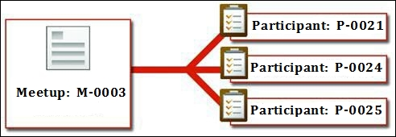
Master-Detail Relationship:
It is a strongly coupled relationship among Salesforce objects, which means if a master record gets deleted, then the child records associated with it are also deleted.
In this type of relationship, the parent record controls the behavior of the child record regarding visibility and sharing.
It means the security setting of a parent object applies to the child object.

Slide 38
Master-Detail Relationship
When there is a master-detail relationship between two objects, you can create a unique type of field over the master object, called Roll-up summary.
A roll-up summary field allows us to calculate values from child records, such as the number of child records linked to a parent record.

Slide 39
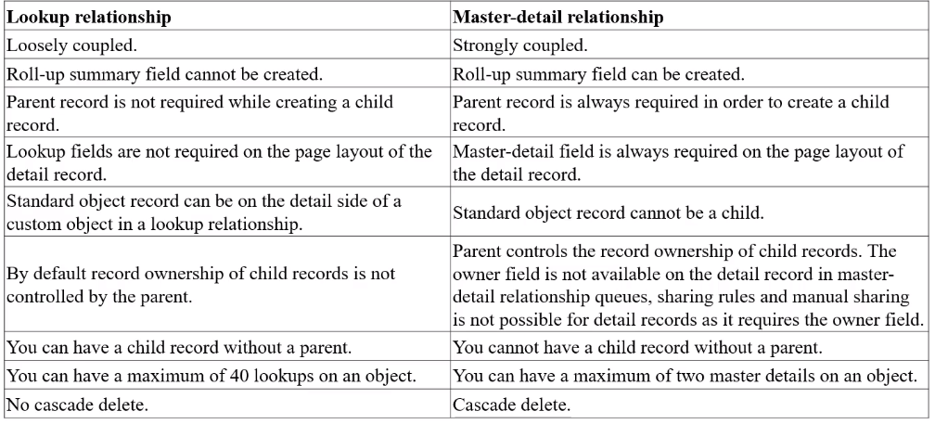
Difference between master-detail and lookup relationships

Slide 40
Roll-up Summary
Roll-up Summary Fields in Salesforce summarize data from a set of related detailed records and automatically display the output on the master record.
These can be used to display the sum, maximum, minimum value of a field in a related list, also the count of all the records listed in a related list
They are only available to master objects in a master-detail relationship.
After creating a Roll Up Summary Field on an object, the master-detail relationship cannot be converted into a lookup relationship.

Slide 41
Create Roll-up summary field
Calculate Total Rating of the Job application

Slide 42
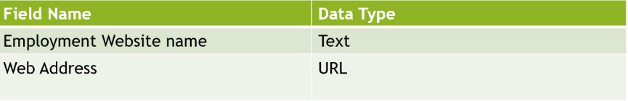
Create a New Object
(Employment Website)

Slide 43
Many to Many relationship
A many-to-many relationship allows each record of one object to be linked to multiple records from another object and vice versa.
Position
Employment Website

Slide 44
How to create Many to Many relationship?
When modelling a many-to-many relationship, you use a junction object to connect the two objects you want to relate to each other.
Junction Object
A custom object with two master-detail relationship. Using a custom junction object, you can model “many-to-many” relationship between two objects.

Slide 45
Many to Many relationship
Position
Junction Object
(Job Posting)
Employment Website
One to many

Slide 46
Job Posting Object

Slide 47
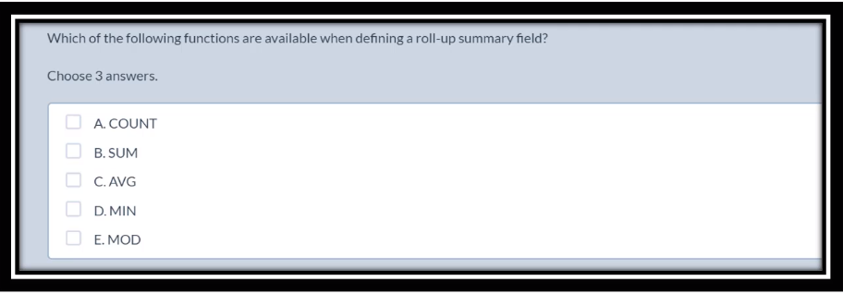
Exam Questions

Slide 48
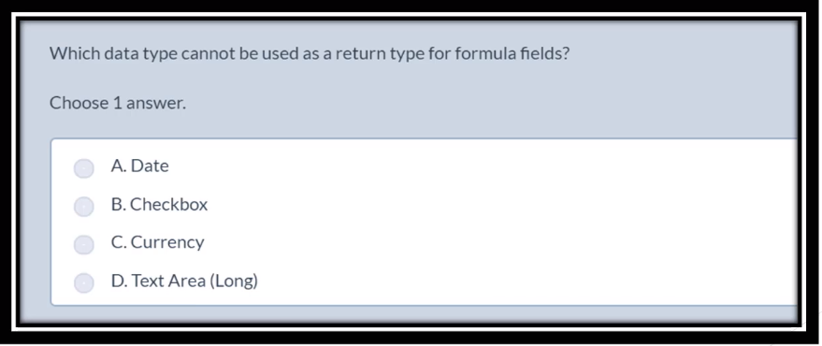
Exam Questions

Slide 49
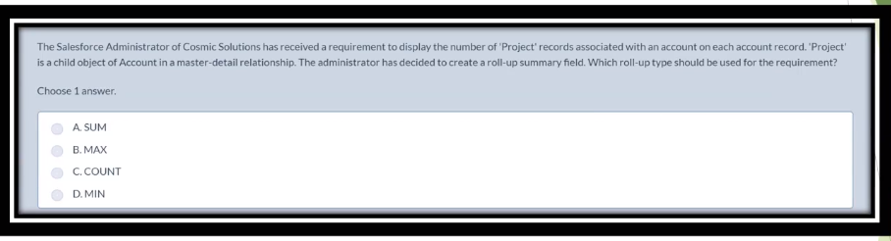
Exam Questions

Slide 50
Importing and Exporting Data
When building and maintaining apps on the Lightning Platform, there are occasions when you, as an app builder, need to either import or export data.
User-generated data needs to be imported when you are migrating from an external data management system or from spreadsheets into Salesforce.
For e.g.: User-generated data can also originate from lists of contacts or prospects, which a sales or marketing team would purchase, such as lists of new leads or contacts that are contained in marketing spreadsheets.

Slide 51
Data Import in Salesforce
Data can be easily imported into Salesforce through various tools provided by Salesforce. Supported data sources include any program that can save data in the comma delimited text format(.csv).
There are 3 operations possible while Importing Data in Salesforce:
Insert: It simply creates new records in Salesforce.
Update: It modifies existing records in Salesforce with the help of record id or external id.
Upsert: It is a combination of insert and update. It modifies the existing records and if the record is not present in the org, it creates a new record for it.

Slide 52
Ways of Importing Exporting Data
Data Loader: Importing and exporting data
Data Import Wizard: Importing data
Data Export: Exporting data

Slide 53
Importing and Exporting Data
using Data Loader
Data Loader is a standalone application that is provided by Salesforce to enable the importing and exporting of data to and from the lightning platform.
Data Loader software must be installed on your local computer.

Slide 54
Data Loader
Insert Position record via Data Loader.
Export Candidate Data Using Data Loader.
Updating Records via Data Loader.

Slide 55
Features of Data Loader
An easy-to-use wizard interface for interactive use.
An alternate command line interface for automated batch operations.
Support for large files with upto 5 millions records
Drag-and-drop field mapping
Support for all objects, including custom objects
Can be used to process data in both Salesforce and Database.com
Detailed success and error log files in CSV format

Slide 56
Data import Wizard
This tool, accessible through the Setup menu which lets us import data in common standard objects, such as contacts, leads, accounts, opportunities, as well as data in custom objects.
It can import up to 50,000 records at a time.
It provides a simple interface to specify the configuration parameters, data sources, and field mappings that map the field names in your import file with the field names in Salesforce.

Slide 57
Using Data Import Wizard
Insert Candidate Records via Data Import Wizard.
Update Candidate Records via Data Import Wizard

Slide 58
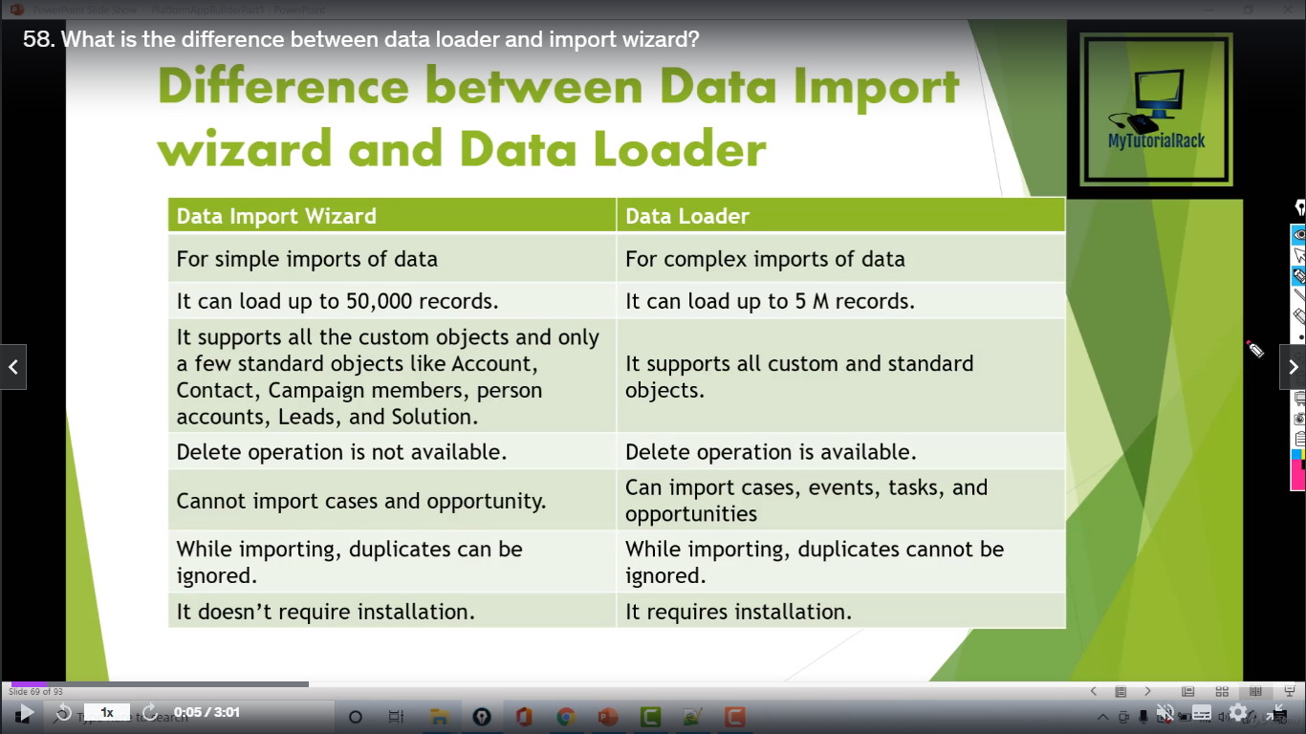
Difference between Data Import Wizard and Data Loader

Slide 59
Important Points to remember:
Multi-Select Picklists:
To import multiple values into a multi-select picklist, separate the values bbby a semicolon in your import file.
Checkboxes:
To import data into a checkbox field, use 1 for checked values and 0 for unchecked values.
Default Values:
For picklist, multi-select-picklist, and checkbox fields, if you do not map the field in the import wizard, the default value for the field, if any, is automatically inserted into the new or updated record.

Slide 60
Important Points to remember:
Data/Time Fields:
Ensure that the format of any data/time fields you are importing matches how they display in Salesforce per your locale setting.
Formula Fields:
Formula fields cannot accept imported data because they are read-only.
Field Validation Rules:
Salesforce runs validation rules on records before they are imported. Records that fail validation aren’t imported. Consider deactivating the appropriate validation rules before running an import if they affect the records you are importing.
Universally Required Fields:
You must include universally required fields in your import files or the import will fail.

Slide 61
Level of Data Access
Organizational Level
The access to the whole organization is secured at this level by maintaining a list of authorized users, setting password policies, and limiting login access to certain hours and certain locations.
Object Level
Object-level security provides the simplest way to control which users have access to which data. By setting permission on a particular type of object, you can prevent a group of users from creating, viewing, editing, or deleting any records of that object.
Field Level
Field level security restricts access to certain fields, even for objects a user already has access to.
Record Level
Record Level security lets users access some records but not others. It is used to control data access with greater precision. Users can have access to view an object, but can be restricted to the individual records.

Slide 62
Profiles
Profiles is a collection of settings and permissions that determine which data and features in the platform users have access to.
Settings determine what users can see for example apps, tabs, fields, and records\ type whereas Permission determine what users can do for example create or edit records of a certain type, run reports and customize the app.

Slide 63
What does Profile Control?
Object Permission
Field Permission
User Permission
Tab Settings
App Settings
Apex class access
Visualforce page access
Page Layouts
Record Types
Login Hours
Login IP Ranges

Slide 64
Notes:
Object permissions on the Standard profile cannot be edited. So to overcome through this it is good to make copies/clones of standard profiles and then customize the copies to fit the needs of the organization.
The profile functionality in an organization depends on the user licence type.
Every profiles should have at least one visible app.
If an app is visible, its tab won’t show up unless a profile has permission to view the associated objects.
A profile can be assigned to many users but the user can be assigned to only one profile at a time.

Slide 65
Permission Sets
Permission sets in Salesforce are also a collection of settings and permissions that determine user’s access to various tools and functions on the platform.
Settings and permissions available access in permission sets are also found in profiles but permissions sets extend the functionality of users without changing their profiles.
User permission set to grant additional access to specific users on top of their existing profiles permissions, without having to modify an existing profile, create new profiles, or grant an administrator profile where its not necessary.

Slide 66
What does Permission Set Control?
Object Permission
Field Permission
User Permission
Tab Settings
App Settings
Apex class access
Visualforce page access

Slide 67
When to use Permission Set?
To grant access to custom objects or entire apps.
To grant permissions-temporarily or long term-to specify fields.
Permissions are additive which means we can’t remove a user’s existing permission by assigning a permission set we can only add permission.
To limit access for a user or group of users, ensure that their base profile as well as any or their permission set limits this type of access.
The licence type cannot be changed once assigned. And it is not mandatory while creating the permission set.

Slide 68
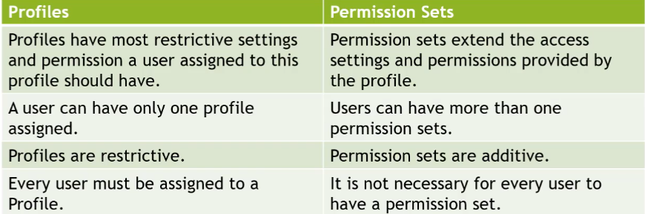
Difference between Profiles and Permission Sets

Slide 69
Exercise
There is a Profile system administrator and Two users user1 and user2 will have the same profile. We have a requirement that User1 must have access to marketing app.

Slide 70
Exercise

Slide 71
Record Level Access

Slide 72
Record Level Access
Record access determines which individual records users can view and edit in each object they have access to in their profile.
The permissions on a record are always evaluated according to a combination of object-level, field-level, and record-level permissions.
There are 4 different mechanisms that control record-level sharing among different sets of users.
Organization-wide defaults
Role hierarchy
Sharing rules
Manual sharing and team sharing

Slide 73
Organization-wide defaults:
Objects permissions (Create, Read, Edit, Delete) control what users can do with records they own.
The Organization-wide default (OWD) defines the level of access each user has for records for a particular object. OWD provides the baseline-level access that the most restricted user should have.
We can use org-wide defaults to lock down our data, and then use the other record-level security and sharing tools (role hierarchies, sharing rules, and manual sharing) to open up the data to users who need it.
Org-wide sharing settings can be set separately for each type of object (Standard Objects and Custom).
Object permissions determine the baseline level of access for all the records in an object. Org-wide defaults modify those permissions for records a users doesn't own.

Slide 74
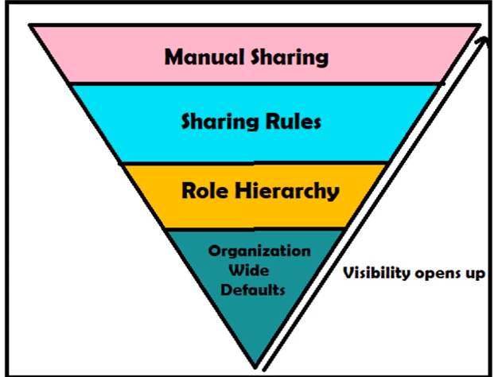
Record
Level Access

Slide 75
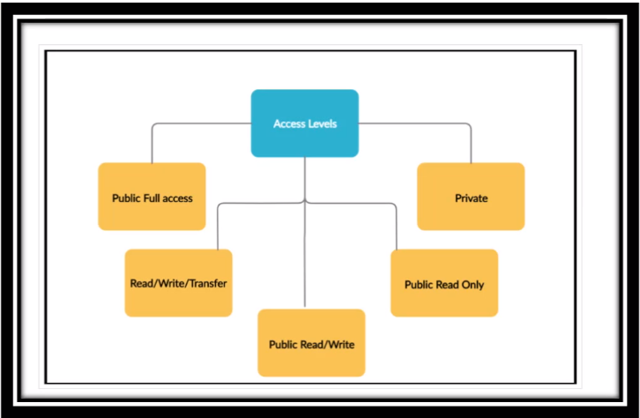
OWD Access
Levels

Slide 76
OWD Access Levels
Public Read/Write: All users can view, edit, and report on all records.
Public Read Only: All users can view and report on records but not edit them. Only the owner, and users above that role in the hierarchy, can edit those records.

Slide 77
OWD Sharing Settings:
Private: Only the record owner, and users above- that role in the hierarchy, can view edit, and report on those records.
Controlled by Parent: A user can perform an action (such as view, edit, or delete) on a contact based on whether he or she can perform that same action on the record associated with it.
Public Read/Write Transfer: All users can view, edit, transfer, and report on all records. Only available for cases or leads.

Slide 78
Points to Remember:
Changing OWD settings and increasing default access ex: From Public Read Only to Public Read/Write will take effect immediately.
Changing OWD settings and decreasing default access in an existing organization with significant data will take some time for salesforce to recalculate user access.
If a custom object is on the detail side of a master- detail relationship with a standard object, the OWD setting will be 'Controlled by Parent' and can not be changed.

Slide 79
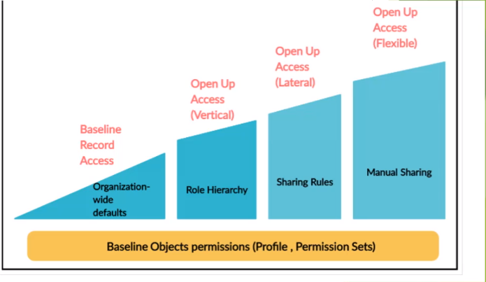
OWD Provides the baseline- level access that the most restricted user should have. So, what we do to open up the access?

Slide 80
Role and Role Hierarchy:
Data visibility can be increased by building role hierarchy.
It is not mandatory that a user should have a role.

Slide 81
Role Hierarchy:
Role hierarchy refers to a set of roles in an organization and the relationship between different roles.
Role hierarchy opens up vertical-level access to records.
Role hierarchy allows the user sitting in higher level have access of records owned by users having role lower in hierarchy.
Users at any role level can view, edit, and report on all data that's owned by or shared with users below them in their role hierarchy, unless your org's sharing model for an object specifies otherwise.
As we know Organization wide default sets the default access for objects.
For example: OWD set as private it would mean that only the owner of the record can access the record. But with the help of roles the additional access can be granted to the users of these records to other users ie users higher in role hierarchy would get the access of records owned by users lower in hierarchy.

Slide 82
Assignment
Let's set up a Role Hierarchy
Let's assign roles to the users in the organization.

Slide 83
Grant Access using Hierarchies:
Salesforce uses role hierarchy to automatically grant access to users by default. Role hierarchy allows the user sitting in higher level have access of records owned by users having role lower in hierarchy. It helps to extend the OWD settings for different objects.
We can specify whether users have access to the data owned by or shared with their subordinates in the hierarchy.
The Grant Access Using Hierarchies option is enabled for all objects, and it can only be changed for custom objects. We can not change it for standard objects.

Slide 84
Grant Access using Hierarchies checkbox
The Grant Access Using Hierarchies option is always selected on standard objects and is not editable.
What if not checked?
If Grant Access using Hierarchies check box for custom objects is not checked, only the record owner and users who are granted access by the organization-wide defaults receive access to the object's records.
What if checked?
When Grant Access using Hierarchy is checked for custom object even if the record is private users higher in the role and the owner of the record still gets access to the records.

Slide 85
Sharing Rules
Using sharing rules we can share a record with multiple users who are connected by horizontal hierarchy. With Sharing Rules we can extend sharing access to user, roles or territories. This enables us to make automatic exceptions to our org- wide sharing settings for selected sets of users.
If we have org-wide sharing defaults of Public Read Only or Private, we can open access back up for some users with sharing rules.

Slide 86
Types of sharing rules:
Owner-Based Sharing Rules
Criteria-Based Sharing Rules

Slide 87
Owner-Based Sharing Rules:
An owner-based sharing rule opens access to records owned by certain users. We can provide which user's records to whom and provide the access to what level like read only or read/write.
For Example: A sharing rule can be used to grant read only access to records owned by users with the ‘North marketing role to the south marketing role'.

Slide 88
Criteria-Based Sharing Rules:
A criteria-based sharing rule determines with whom to share records based on field values. If we want to share the records with specified groups or roles, then we can use criteria based rules.
The criteria can be created with object's fields.
Note: We can't use Apex to create a criteria-based sharing rule. And we can't test criteria-based sharing using Apex.
For example: We have a object Contact, with a field Name. A criteria-based sharing rule could share all Contact Records in which Contact name contains with specified string (Technologies), with all Marketing managers in our organization.
We can define up to 300 sharing rules for each object, including up to 50 criteria-based sharing rules per object.

Slide 89
Criteria-Based Sharing Rules:
You can create criteria-based sharing rules for accounts, assets, campaigns, cases, contacts, leads, opportunities, work orders, and custom objects. For the sharing criteria, record types and these field types are supported.
Auto Number
Checkbox
Date
Date/Time
Email
Lookup Relationship (to user ID or queue ID)
Number
Percent
Phone
Picklist
Text
Text Area
URL

Slide 90
Public group:
A public group is a collection of individual users, other groups, individual roles or territories, and/or roles or territories with their subordinates that all have a function in common.

Slide 91
Points to Remember:
We can use sharing rules to grant wider access to data. We cannot matrict access below our organization-wide default levels.
To create sharing rules, your organization-wide defaults must be Public Read Only or Private.
The user can access related records automatically with sharing rules.
Sharing rules apply to both active and inactive users.
If multiple sharing rules give a different levels of access to a record, the user gets the most permissive access level.
Once a sharing role has been saved, We can't change the Share with field settings when you edit the sharing rule.
Sharing rules apply to all new and existing ends that meet the definition of the source data set.
When We delete a sharing rule, the sharing access created by that rule is automatically remove.
When we transfer records from one user to another, the sharing mes are reevaluated to add or remove access to the transferred reeds as necessary.

Slide 92
Salesforce Data Security and Access (Manual Sharing)
Users can manually share records with other users using the sharing button.
We can use manual sharing to give specific other users access to certain types of records, including accounts, contacts, leads, users, and custom objects.
Manual sharing provide additional access beyond the organization-wide defaults and sharing rules.

Slide 93
Manual sharing is available:
To Manually share the record, the user must be either the owner of the record, above the owner in the role hierarchy, a user with full access or an administrator.
The sharing button will only display if appropriate. Ex-OWD setting for the object is private or public read only.

Slide 94
View All,Modify All Vs View All Data and Modify All Data View All:
View All:
We can grant "View All" or "Modify All" permission for an object on a profile or using a permission set. It is a object permission that is found in profiles and allow access to all records of the object.
View All grants read access to the object and read only access to all records associated with a given object across the organization.
The "View All" and "Modify All" permissions ignore sharing rules and settings.

Slide 95
Why do we need View All and Modify All:
Used For:
Users who have "View All Data" and "Modify All Data" permissions can access data cleansing, deduplication, mass deletion, mass transferring, and managing record approvals.
Users with View All Data or Modify All Data permission can view or modify all apps and data, even if the apps and data are not shared with them.
Users who need:
Administrators of an entire organization.

Slide 96
View All Data:
"View All Data" and "Modify All Data" permissions are assigned via profile or permission set.
View All Data will grant read access to all objects and records, provide ability to see all data in the organization.
Modify All Data:
Modify All Data will grant create, read, edit, and delete to all objects as well as full access to all records, provide ability to edit and delete all data in organization.

Slide 97
View All Data and Modify All
Data
Apart from View All and Modify All permissions for a certain object, there are also "View All Data" and "Modify All Data" permissions.
"View All Data" and "Modify All Data" provide full access to all objects in the organization.
These options are essential for the administrators, as it allows them to manage all data in the organization.

Slide 98
View All,Modify All Vs View All Data and Modify All Data View All:
View All:
We can grant "View All" or "Modify All" permission for an object on a profile or using a permission set. It is a object permission that is found in profiles and allow access to all records of the object.
View All grants read access to the object and read only access to all records associated with a given object across the organization.
The "View All" and "Modify All" permissions ignore sharing rules and settings.

Slide 99
Modify All:
Modify All grants read, edit, and delete access to the object and full access to records within that object.
"View All" and "Modify All" can be better alternatives to the "View All Data" and "Modify All Data" permissions.
Used For: Delegation of object permissions.
Users who need: Delegated administrators who manage records for specific objects.
View All and Modify All are not available for ideas, price books, article types, and products.

Slide 100
Recycle Bin in Salesforce Lightning Experience
Yes we can access our deleted records in the Lightning Experience Recycle Bin.
Admins have access to view, restore, and permanently delete the items in their own Recycle Bin and their Salesforce org's Recycle Bin, without switching back to Classic.
In Salesforce Classic org's Recycle Bin is named as "All Recycle Bin" and in Lightning experience the org's Recycle Bin is called "Org Recycle Bin".

Slide 101
Important Info:
Records in the Recycle Bin don't count against your Salesforce org's storage usage.
The Recycle Bin record limit is 25 times of our org's MB storage capacity as records.
For example: If organization has storage allocation of 1,000 MB (1GB),recycle bin can have 25,000 records.

Slide 102
How long does the data stay in
recycle bin?
15 days
Deleted records remain in the Recycle Bin for 15 days, and can be restored during that time.

Slide 103
Record Types and Page Layouts
Record Types let you offer different business processes, picklist values, and Page Layouts to different users.
Page Layouts determine which fields are displayed to your users on a record. They allow you to add fields, sections, links, custom buttons, and a few other features.

Slide 104
Automation Tools
Salesforce offers many automation tools like Approval processes, Workflows, Process Builder, and Cloud Flow Designer to automate the business processes.

Slide 105
Workflows in Salesforce
Workflow lets you automate standard internal procedures and processes to save time across your org. A workflow rule is the main container for a set of workflow instructions. These instructions can always be summed up in an if/then statement.

Slide 106
Workflow rules can be broken into two main components.
Criteria: the "if" part of the "if/then" statement. In other words, what must be true of the record for the workflow rule to execute the associated actions.
Actions: the "then" part of the "if/then" statement. In other words, what to do when the record meets the criteria.

Slide 107
Let's create some Workflow
Send an email to the Hiring Manager, when a New positions moves to Open- Approved status.
Create a task to contact Recruiter on Position Approval for Hiring manager.
Update the Open Date field to today's date when the position gets into Open-Approved status.

Slide 108
Let's create some Workflow
Send an email to the Hiring Manager, when a New positions moves to Open- Approved status.
Update the Open Date field to today's date when the position gets into Open-Approved status.
Create a task to contact Recruiter on Position Approval for Hiring manager.

Slide 109
Time -triggered workflow
Time-Dependent Action: Time-Dependent actions execute at a specific time defined by you, such as sending an Email alert after 24 hours of lead creation if the lead is not contacted. When the specified time passes, workflow rule re-evaluates to check that record still meets the rule criteria.

Slide 110
How to monitor time based workflow?
When a workflow rule is triggered, all the Time-Dependent actions will be placed in the workflow queue.
You can check the queued time-based actions by navigating to Setup-> Monitor-> Time-Based Workflow.

Slide 111
Example
Send an email to the Position owner, if the position is still open after 15 days

Slide 112
Important Notes
Time trigger actions cannot be added to active salesforce workflows. To add a time trigger action first deactivate the workflow rule then add an action.
Another time trigger cannot be added if there is already a time trigger action scheduled for that object and present in a time-based workflow queue.
The action a workflow rule takes can also trigger the execution of other workflow rules.

Slide 113
Approval process
The steps necessary for a record to be approved and who approves it at each step. For example, when an employee creates a time-off request, have Salesforce automatically send an approval request to the employee's manager.
The actions to take based on what happens during the approval process. For example, if a time-off request is approved, update fields on the employee's record. But if the request is rejected, send a notification to the employee

Slide 114
Approval Process
Approval Process in Salesforce is an automated process that an organization uses to approve records in Salesforce.
Records submitted for approval are approved by the users in the organization.
These users are called as Approvers. It is bound to a single object because when a rule is defined this object influences the fields that will be available to set the criteria.

Slide 115
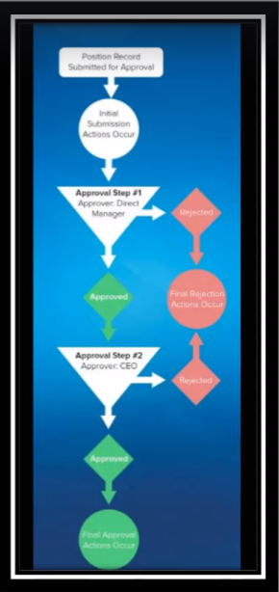

Slide 116
Create approval process
We will create an approval process for the position object.
If the position Min pay >100,000 it needs an approver from Senior Manager.
If the position min pay >200,000 it also needs an approver from Director of Sales.
If the position min pay >500,000 it also needs an approver from CEO (let's make Will smith the VP of sales and marketing)

Slide 117
Queue
Queues allow groups of users to manage a shared workload more effectively.
A queue is a location where records can be routed to await processing by a group member.
The records remain in the queue until a user accepts them for processing or they are transferred to another queue.
You can specify the set of objects that are supported by each queue, as well as the set of users that are allowed to retrieve records from the queue.

Slide 118
Considerations for Setting Approvers
Users with the following permissions can respond to approval requests, even if they aren't designated approvers.
"Modify All Data"
"Modify All" for an object
Make sure that the assigned approver has access to read the records for the approval requests. For example, a user who can't view expense records can't view expense approval requests.
Approval processes that let users select an approver manually also let users select themselves as the approver.
You can assign an approval request to the same user multiple times in a single step. However, Salesforce sends the user only one request.
Here's what happens to the list of approvers after a record enters an approval step and the approval process later returns to that step.
If the user who responded isn't in the designated approvers list and has either "Modify All Data" or "Modify All" permissions for the object, that user replaces the original approver in the list of approvers.

Slide 119
Assigning Approval Steps to Queues
Any queue member can approve or reject an approval request that is assigned to the queue.
Approval request emails are sent to the queue email address. If the queue is set up to send email to members, approval request emails get sent to the queue members, unless their approval user preferences are set to never receive approval request emails.
Salesforce mobile app notifications for approval requests aren't sent to queues. For each approval step involving a queue, we recommend adding individual users as assigned approvers, so at least those individuals can receive the approval request notifications in the Salesforce mobile app. To have both queues and individual users as assigned approvers, select Automatically assign to approver(s) instead of Automatically assign to queue in the approval step.
When an approval request is rejected and returned to the previous approver and the previous approver was a queue, the approval request is assigned to the user who approved it instead of the queue.
The Approval History related list displays the queue name m the Assigned To column and the actual user who approved or rejected the approval request in the Actual Approver column.

Slide 120
What is Process Builder?
Many of the tasks you assign, the emails you send, and other record updates are vital parts of your standard processes. Instead of doing this repetitive work manually, you can configure processes to do it automatically.
Process Builder helps you automate your business processes and gives you a graphical representation as you build it.

Slide 121
What can you do with Process Builder?
Create a record of any object type
Update any related record-not just the record or its parent
Use a quick action to create a record, update a record, or log a call
Invoke a process from another process
Launch a flow-you can't schedule this action with workflow
Send an email
Send a custom notification
Post to Chatter
Submit a record for approval

Slide 122
Why use Process Builder in Salesforce?
Process Builder is used for automating your business processes without writing even a single line of code. Rather it uses a user-friendly, visual representation to make it easier for you to work with.
Easy to use: The visual breakdown provided by Process Builder enables you to know in a glance what exactly you need to expect in every process.
Quick development: With Process Builder, applications are developed faster at half of the cost.
It can combine multiple workflows into a single process and can have a chain of criteria (if-then statements).
Child records can be updated in Process Builder.
Chatter groups and email alerts, both can be notified using Process Builder.
Multiple actions can be associated with each criterion.
Apex code and simple tasks can be accessed and replaced by Process Builder.

Slide 123
Let's create a process
If the position status is New and has Hiring Manager field populated, then automatically submit the record for approval.
Once the record gets submitted for approval, update the status of the position to Pending approval.
After the position has been approved, create a related Job Posting record to post the position on LinkedIn.
If the position status is updated to Closed-not approved, then send an email to the Hiring Manager of the position and also assign a task for the owner of the record to fix the record.

Slide 124
Flows in Salesforce
Flows allow you to build complex business automation using clicks instead of code. As an admin, Flows are going to be your best friend because you will be able to handle the majority of complex business requirements without the help of a Salesforce developer!
The benefit of Salesforce Flow is that they are easy to maintain because anyone (assuming they know Flows) should be able to follow along with what you built.

Slide 125
Types of flows
Autolaunched Flows
These Salesforce flows can be used for running automated tasks in Salesforce. They can be invoked by users from process builder, Apex class, record changes, set schedule, or platform events.
Schedule-triggered Flows
These are autolaunched flows that can be launched at a specific time and for a specific frequency for every record in batches. These flows run in the background for automating your business processes.
Screen Flows
These Salesforce flows have a distinct UI element and require inputs from Salesforce users. You can launch screen flows either as an action or embed them as an element on a Lightning page.
Record-triggered Flows
These are the auto launched flows that run in the background when a user creates, updates, or deletes Salesforce records.
Platform Event-triggered Flows
These Salesforce flows run in the background when a platform event message is received.

Slide 126
Time to create some flows
I do have a separate course related to flows. Name of the course is " Salesforce Lightning Flow Builder Complete Course"
Whenever a case status is updated to closed, you want to create a chatter post.
Ask the user for his survey and store that information in a custom object in salesforce.
Whenever an opportunity is closed won, you want to send an email to opportunity owner.

Slide 127
Scheduled Triggered Flows
With schedule-triggered Flows, you can potentially avoid using Apex Schedule Jobs using Batch Apex. Now you have the option of meeting repetitive business requirements without using the development capabilities of the platform. For example, sending birthday greetings every morning to customers who have their birthdays on that day, or closing Cases every night that are in a specific status after a certain number of days has passed.

Slide 128
Flow Requirement
Create a scheduled triggered flow which updates the priority of case to high for all the cases which are in new status.

Slide 129
Platform Event Triggered Flow
With platform event-triggered flows, you can do all your automation in one place. Users can trigger a Flow when a platform event message is received.
What is Platform Event?
Platform Event is based on Event-Driven Architecture which enable apps to communicate inside and outside of Salesforce. Platform events are based on the publish/subscribe model and work directly with a message bus which handles the queue of incoming events and processes listening for them. This is built in real time integration patterns in the Salesforce Platform which helps to reduce point-to-point integration.

Slide 130
Platform Event Triggered Flow

Slide 131
Auto-launched flows
Auto launched Flow is leveraged to automate complex business processes without writing code. It can be auto launched from Apex class or Process Builder when a record is changed while inserting, updating, or deleting.
This flow type doesn't require any user interaction to start. They won't include steps, screens, choices, or dynamic choices in the flow.
Auto launched Flows can be launched when invoked by Apex classes, process builders, or REST API. These flows are launched automatically based on specific events or conditions.
Auto launched flows provide abstraction, as you can define the complex processes to be carried out in the background without a user knowing the details.

Slide 132
Business Scenario
For instance, Marvel Industries plans to focus on improving their customer experience and wants to ensure whenever the new Opportunity arises with the type as a New Customer.
Firstly, the Opportunity should be changed to the Qualification stage so that the VP of sales can better understand the sales process.
Secondly, the task should be created for the Sales Rep who owns the Opportunity to call the customer and get more details.
Finally, a Welcome email should be sent to the customer notifying them about a call that has been scheduled with the sales representative.

Slide 133
Create an Auto-launched flow
We are getting the value of Opportunity Stage name based on the opportunity id that we are passing from the apex code.

Slide 134
Top 4 Salesforce standard
objects:Lead
Lead object is used to store information about a person interested in the product or service we are delivering. In business terms, leads are the people who are your potential customers.
It contains some information about a company and the information of a person working in that company. Hence Lead in Salesforce can be considered as a business card.
Lead conversion means qualifying a lead for the sales process.
Lead management is a process that allows us to measure and monitor lead conversion.
Sales reps get instant access to the latest prospects and ensure that leads are never dropped.

Slide 135
Important fields of Lead object
Company:
Name of the company with which the lead is affiliated.
Title:
Position of lead within his/her own company.
Lead Status:
This field specifies the status on which the lead is. For example, Open, Contacted, Working, Closed-Converted, or Closes-Not Converted."
Lead Source:
This field specifies the source from which the lead is captured. It can be anything like Web, Purchased List, and Partner Referrals etc.

Slide 136
Related Lists of Lead:
Campaign History
Campaign & Leads are related through a junction object i.e. Campaign Member.
Campaign History related list describes that in which campaign this particular lead has been added as a member and also it's status for that campaign. When we initially create a lead record and add the campaign through a lookup dialog then also it is added to campaign history, not as a field.

Slide 137
Web to Lead
The process of capturing leads from a website is called Web-to-Lead. It allows organizations to generate a web form that they can add in their company's website using which people can register themselves as a lead and show their interest in your product, the entries in that webform when submitted, creates a lead record within Salesforce.com.
To allow the leads to be submitted through the web we need to enable web-to-lead then we need to create a web form. While generating the web form we can specify the fields we would like to capture from leads.
In web-to-lead form fields like Name and email should always be set explicitly. It asks for the return URL also where the page will be redirected when the lead will be submitted through the web form. Web- to-Lead is limited to receiving 5000 leads per day.
Salesforce runs field validation rules before creating records submitted via Web-to-Lead and only creates records that have valid values.

Slide 138
Web to Lead
The process of capturing leads from a website is called Web-to-Lead. It allows organizations to generate a web form that they can add in their company's website using which people can register themselves as a lead and show their interest in your product, the entries in that webform when submitted, creates a lead record within Salesforce.com.
To allow the leads to be submitted through the web we need to enable web-to-lead then we need to create a web form. While generating the web form we can specify the fields we would like to capture from leads.
In web-to-lead form fields like Name and email should always be set explicitly. It asks for the return URL also where the page will be redirected when the lead will be submitted through the web form. Web- to-Lead is limited to receiving 5000 leads per day.
Salesforce runs field validation rules before creating records submitted via Web-to-Lead and only creates records that have valid values.

Slide 139
Lead Assignment rules
Salesforce Lead Assignment Rules are used to automatically assign lead records to a particular user or queue based on different conditions. It can contain many rule entries that determine the assignee of a lead.
Rule entry specifies the:
Sort Order which determines the order of evaluation of rule entries.
Entry criteria which determines that the response will be sent through which rule entry.
Name of the user/queue to which the record should be assigned.
Email template which will be used to send the response.
We can create as many assignment rules as we want but only 1 can be active at a time. "Don't Reassign Owner" determines if the user whose process stack is in use becomes the owner of the rule entity, or if it remains owned by its creator user.

Slide 140
Lead Assignment Rules
Create an assignment rule, which will route the lead record based on country.
If country equals US, assign it to Will Smith
If country equals IN, assign it to Deepika Khanna

Slide 141
Salesforce Standard Objects
Account : The Account object enables the management of company information for the organizations that your organization is involved with. Accounts may be considered as business accounts from a Business-to-Business (B2B) perspective and are usually the company records stored within the Salesforce CRM application.
Account act as the parent object for other standard objects, such as contacts, opportunities, opportunities, and cases.

Slide 142
Features and capabilities of Account Object
Account Hierarchy: By associating an Account record in the standard Parent Account field, a hierarchy of accounts can be established.
View Account Hierarchy: This feature enables users to see the full association of parent and child Account records within the account hierarchy.
Account Teams: This feature enables the granting of access to Account records for specific users who work on the same account. The feature can be used by users that are the owner of the Account record (or users that are above them in the role hierarchy and system administrators). This feature is disabled by default and there can only be one Account team but with multiple roles.
Account Merge: This feature enables up to three Account records to be merged together in a wizard-style dialog. B2B accounts and Business-to-Consumer (B2C) person accounts cannot be merged with each other.

Slide 143
Person Account object
The Person Account object is used in the context of a B2C business model and provides a very similar set of features and fields to the standard Account object; however, Person Accounts have some differences.
The Person Account object comprises both an Account object and a Contact object.
Person accounts store information about individual people by combining certain account and contact fields into one record.

Slide 144
Contact Object
Contacts in Salesforce store an individual's demographic information, such as phone numbers and email addresses, and are linked to accounts. If a contact is not linked to an account, then it is a "private" contact and only viewable by the contact owner or Salesforce administrator. One contact = one person
Important field: Lead Source, Reports To
Related Lists:
Campaign History
Campaign and Contact are related through junction objects i.e. campaign members.
It describes that in which campaign this particular contact has been added as a member and also it's status for that campaign.

Slide 145
Opportunity object
Opportunities are deals in progress. Opportunity records track details about deals, including which accounts they're for, who the players are, and the amount of potential sales. If your Salesforce admin has set up leads in your Salesforce org, an opportunity is created when a lead is converted.
The Opportunity object enables the management of sales information. An Opportunity represents a financial transaction, deal, or a pledge between a customer or benefactor and a company or charity.
For nonprofits, this could be donations and for business enterprises, this could be products and services.
Opportunity records are processed using a business sales process with predefined sales stages that typically advance to a final stage of either closed/lost or closed/won, where a closed/won opportunity represents a successful sale or paid donation.
Opportunity records can either be generated from lead conversion or can be entered manually by the sales team.

Slide 146
Opportunity Object
Many Opportunities can be created for one Account if the customer is interested in different packages of products. For new customers, typically the Opportunity is created when the new customer is converted from a Lead to an Account (and Contact too).

Slide 147
Features of Opportunity object
Opportunity Teams: Use Opportunity Teams if there is more than one user involved in a deal. In some companies, more than one person is required to negotiate one deal with a customer; for example, a sales agent and a technical specialist. If that is the case of your company, Opportunity Teams might be a feature you need to set up in your org. Opportunity Teams can be used to give special access to several users to a given Opportunity as well as to split credit among the different users that make up its Opportunity Team.
Contact Roles: Use Contact Roles to indicate the role of a customer contact in a deal. Your potential customers might have more than one person from their side involved in negotiating a deal or there might be one person who has played different roles in different Opportunity negotiations. If that is the case, you can set up Contact Roles for your sales reps to indicate the role of a Contact in a specific Opportunity.

Slide 148
Features Of Opportunity Object
Paths help Sales Reps update Opportunity information along the negotiation process. They display the values you have set up as different stages in your Opportunity process. When a certain stage is selected, you can also display up to 5 fields as key fields for the user to focus on the most important information. A good practice is to enforce validation rules at each of the Opportunity stages to ensure the minimum information necessary is provided.

Slide 149
Case Object
The Case object enables the management of customer issues, feedback, incidents, or questions associated with the products and services that your organization is involved with.
Case records can be manually entered from the Cases tab by users after, say, a phone call or email to or from a customer, and there are various features that support the automation of Cases within the Salesforce CRM and are associated with Contact records and/or Account records.

Slide 150
Features of Case Object
Web-to-Case: This feature enables customers to submit Case records online.
Email-to-Case: This feature enables Case records to be automatically created when an email is sent to pre-configured email addresses.
Auto-Response Rules: This feature allows the sending of an email to respond when Cases have been received in the Salesforce Lightning Platform.
Case Queues: Cases are either manually assigned or they can be automatically assigned to Case queues (or to users) using assignment rules.
Assignment Rules: Only one case assignment rule can be active at any one time, and each rule can contain multiple criteria up to a maximum of 25 criteria. Cases can be automatically assigned to users or queues using assignment rules.
Escalation Rules: Automatically escalates unresolved Cases after a specified period of time.

Slide 151
Reports and Dashboards
Reports are used to display one or more fields for the records that are accessible within the platform and you can choose the appropriate report type that allows for the fields of a given object or set of objects to be selected.
You can imagine that the fields that are selected form a table of data for the report details and you can apply various filters to control the breadth and depth of information that is retrieved and displayed.
Salesforce recommends that in order to improve the performance and enable reports to run quicker, you only include fields that are strictly necessary to display the information that you require and remove any fields that are not needed.

Slide 152
Important Terms
Lightning report builder: The Lightning report builder is a tool with a visual interface that allows you to build reports using point-and-click features to create new reports and edit existing reports within the Lightning Experience user interface, Reports built in Salesforce Classic are compatible in the Lightning report builder.
Report builder: The report builder refers to the Salesforce Classic tool that allows you to build reports using point-and-click features to create new reports and edit existing reports within the Salesforce Classic user interface. Reports built in Lightning report builder are compatible in the Salesforce Classic report builder.
Report format: The report format is used to specify the way in which the report results (rows and columns) are formulated and displayed. The options that are available are tabular, summary, matrix, and joined.
Tabular - This is the simplest of reports and is suited to just showing lines of data and nothing else. It is similar to an Excel spreadsheet. If you just want to show data without the need to show totals, calculations or groups of data, then this is the report for you. It is also best to use this report type if you are planning to export data.
Summary- As soon as you add a grouping, you will turn the report into a summary report. Summary reports are probably the most commonly used and are great for showing groups of data, eg, if you want to see the number or value of opportunities per account, you would group your report by Account Name. You can also subgroup fields by dragging them under the initial group.
Matrix- Matrix reports are very similar to summary, but they allow you to group by rows as well as columns to see different totals. Building on the example above, you might want to see the value of opportunities per account, by month. So you would see that Edge Communications has $100,000 of opportunities in January, $50,000 in February and so on.
Joined Reports - Joined reports allow you to create two separate reports so that you can compare data. You could use a Joined report to show the total number of opportunities and cases per account, side by side.

Slide 153
Create Your Reports
Cases grouped by type (Summary report).
Accounts and Contacts report, containing contacts created this week.
Opportunities that are closed (closed won and closed lost).

Slide 154
Joined Reports
A Joined Report in Salesforce combines two reports that have different report types, within a single view. Salesforce Joined Reports appear like one single report so that you can get a more holistic data view.
In the Lightning Report Builder, you add report blocks, and then define the filters for each block. You can use both standard and/or custom report types as report blocks.
When Should You Use a Joined Report?
Joined Report is designed to show two unrelated reports in one view
For example: Account's related Opportunities and related Cases in one view
We will create a Joined Report:
Block 1: Account report
Block 2: Cases related to the Account
Block 3: Opportunities related to the Account

Slide 155
Joined Report
Reviewing Support Cases by Status

Slide 156
Salesforce Joined Reports: What to keep in mind
Report performance: the more blocks your report contains, the longer it will take to load. If you have more than 2 blocks, use report filters to keep the report view only to the data required
Export: Joined Reports are designed to be visually useful inside of Salesforce, so they don't export into a workable format.
Charts: you can only add one chart to Joined Reports.
With up to five blocks, joined reports let you view different types of information in a single report. Each block shows data from one standard or custom report type.

Slide 157
Custom report types in Salesforce
Custom report types come in when you want to go beyond standard and auto-created report types. Great examples of when you will look to create a custom report type are if you need to:
Report on more than two objects at a time?
Report using 'without a relationship (eg. Contacts without Accounts), instead of just a "with" relationship?
Note: only Salesforce Administrators or users with the 'Manage Custom Report Types' permission can create custom report types

Slide 158
Create Custom Report types
Accounts With or Without Opportunities
Account with or without Contacts
Contacts with Cases
Accounts With Orders and Products
Highlights of Custom Report Types
Multiple Objects: add up to 4 layers of objects as long as they have a parent-child relationship,
Fields via Lookup: you can add fields into the report from any related object,
Sections and fields: create, remove, rename, and reorder,
Default Columns: you can control which columns are already displayed on the report when users create a new one.

Slide 159
Standard object
Salesforce Order object is used to automate an organization's post deal process. You can create an Order using either Account or Contract in Salesforce, and then track order information using Orders tab.
Products are the items and services that you sell to customers. Each product can exist in multiple price books with different prices
The standard price book is the master list of all your products and their default standard prices. Salesforce creates the standard price book when you start you start creating product records. It includes all your products and their standard prices regardless of any custom price books that include those products.
A custom price book is a separate list of products with custom prices, called list prices. Custom price books are ideal for offering products at different prices to different market segments, regions, or other subsets of your customers. Create a separate price book for each set of customers that you want to address. For example, if you have one set of prices for domestic customers and another for international customers, create a domestic price book and an international one.
An order product is a product or service that's provided to a customer according to an associated order.

Slide 160
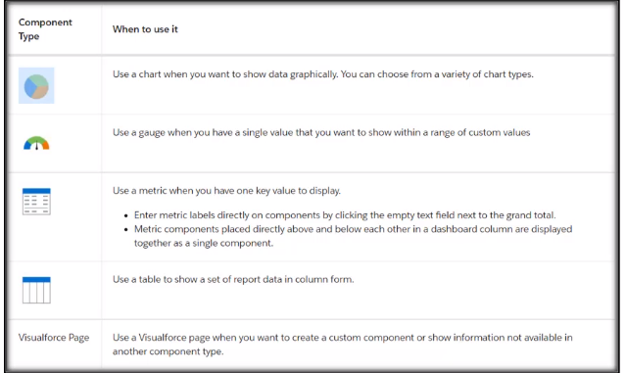
Dashboards
Dashboards are a way to visually represent the reports you have created. You can add charts to your reports but dashboards give you more options and also the ability to add up to 20 charts and tables on one page for a quick view of multiple reports.

Slide 161
Dashboards
Leads by Lead Source
Closed Won Opportunities by Month

Slide 162
Dynamic Dashboards: Choose Who People View a Dashboard as in Lightning Experience
Me- Dashboard readers see data in the dashboard according to your access to data. For example, if you can only see Opportunities in Canada, then dashboard readers only see data about Opportunities in Canada.
Another person- Dashboard readers see data in the dashboard according to the data access level of whomever you specify. For example, if you choose someone who can see Opportunities from any country, then dashboard viewers see data about Opportunities from all countries. If you have View All Data permission, you can choose any user in your organization to be the running user. If you have View My Team's Dashboards permission, you can choose any user below you in the role hierarchy.
The dashboard viewer- Dashboard viewers see data as themselves, according to their own access to data. These types of dashboards are called dynamic dashboards. Your organization can have up to 5 dynamic dashboards for Enterprise Edition, 10 for Unlimited and Performance Edition, and 3 for Developer Edition. Dynamic dashboards aren't available in other editions. In some cases, additional dynamic dashboards are available for purchase.

Slide 163
Subscribe to Dashboards
Subscribe to dashboards to refresh them on a schedule that you set (daily, weekly, or monthly), and receive the refreshed dashboards results by email. You can subscribe to dashboards yourself and add other users, groups, and roles.
For example, to review a dashboard at the start of business every week, set the schedule to receive the dashboard weekly on Monday at 8:00 AM.
Note: You can't subscribe to dashboards that are configured to display data as The dashboard viewer under View Dashboard As settings in Dashboard Properties.

Slide 164
AppExchange
Salesforce AppExchange is Salesforce.com's cloud computing marketplace through which end users can access, download and install software apps.
AppExchange offers a mix of free and paid apps organized into collections, categories and industry solutions that encompass a variety of fields, including small business, customer service, education, manufacturing and real estate.

Slide 165
Let's download Apps from AppExchange
FieldTrip
Salesforce CRM Dashboard (Classic)
Dashboard Pack
In-app Guidance walkthrough (Setup->in-App)

Slide 166
Let's download Apps from AppExchange
FieldTrip
Salesforce CRM Dashboard
In-app Guidance walkthrough (Setup->in-App)

Slide 167
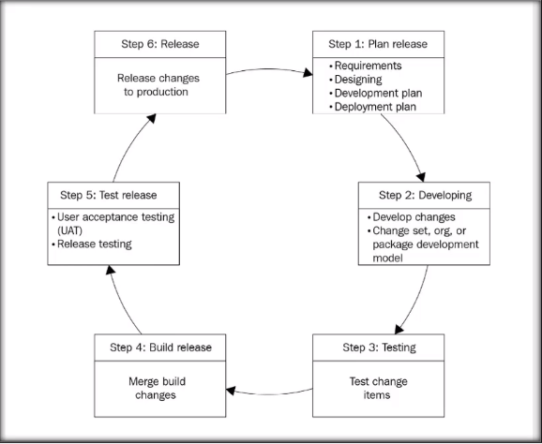
Application Lifecycle

Slide 168
Step 1: Plan Release
Start your customization or development project with a plan. Gather requirements and analyze them. Have your product manager (or equivalent) create design specifications and share them with the development team for implementation. Determine the various development and testing environments the team needs as the project progresses through the AIM cycle.
Step 2: Develop
Complete the work, following the design specifications. Perform the work in an environment containing a copy of the production org's metadata, but with no production data. Develop on Lightning Platform using an appropriate combination of declarative tools (Process Builder, the Custom Object wizard, and others in the UI) and programmatic tools (Developer Console, Source Code Editor, or Visual Studio Code).
Step 3: Test
Exercise the changes you're making to check that they work as intended before you integrate them with other people's work. Do your testing in the same type of environment as you used in the develop step, but keep your development and integrated testing environments separate. At this point, focus on testing your changes themselves, not on understanding how your changes affect other parts of the release or the app as a whole.
Step 4: Build Release
Aggregate all the assets you created or modified during the develop stage into a single release artifact a logical bundle of customizations that you deploy to production. From this point on, focus on what you're going to release, not on the contributions of individuals.
Step 5: Test Release
Test what you're actually going to deploy, but test safely in a staging environment that mimics production as much as possible. Use a realistic amount of representative production data. Connect your test environments with all the external systems they need to mimic your production systems integration points. Run full regression and final performance tests in this step. Test the release with a small set of experienced people who provide feedback (a technique called user-acceptance testing).
Step 6: Release
When you've completed your testing and met your quality benchmarks, you can deploy the customization to production. Train your employees and partners so they understand the changes. If a release has significant user impact, create a separate environment with realistic data for training users.

Slide 169
What is a Sandbox?
Salesforce sandboxes are copies of your Production environment. A sandbox contains all the configuration, customization, apps and code (known as metadata) that you have made to your Production environment (where users login and work every day). Some sandbox types can even contain all or some of your production data too.
The benefit of a Sandbox is you can do anything you like in there without any risk of harm to the configuration or data contained in your Production environment.

Slide 170
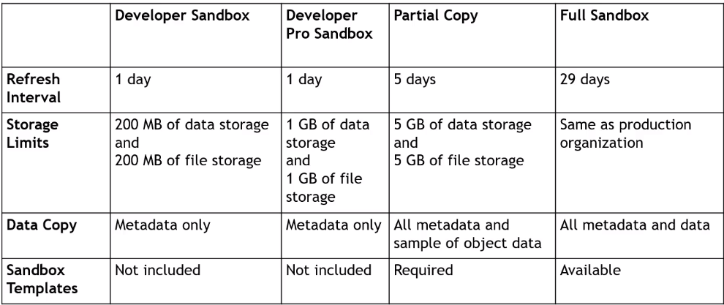
Difference between Different Sandboxes

Slide 171
How can you deploy Metadata?
Changeset: Changeset is useful when you need to migrate the metadata between related organizations. In changeset you need Deployment connection between the orgs.
Force.com IDE
Force.com Migration Tool
Packages (Managed, unmanaged): In the packages you can deploy the metadata across the organizations.
You don't need access/ deployment connections with the other org. So, when you need to deploy the metadata to many orgs, in that case we use packages.
Managed Packages: The components will be locked i.e. you cannot change. Also upgrades to the components will be available.
Unmanaged Package: You can edit the components of the package. Unmanaged package will not have upgrades.

Slide 172
Deployment via Change sets
Use change sets to send customizations from one Salesforce org to another. For example, you can create and test a new object in a sandbox org, then send it to your production org using a change set. Change sets can contain only modifications you can make through the Setup menu. For example, you can't use a change set to upload a list of contact records. Change sets contain information about the org. They don't contain data, such as records.
By using change sets we can deploy code from sandbox to sandbox and also we can deploy Sandbox to production.
Prerequisites to deploy by using change sets
A deployment connection between two organizations.
Overall test class code coverage should be greater than 75%.
Create and upload change sets user permission to create or upload change set

Slide 173
How to do deployments using change sets?
Create outbound change set in source organization and upload that change set to Target instance.
In target instance go to inbound change set and go to the change set uploaded from source instance and deploy that change set.
For example, you have done with your customizations in Developer sandbox. You are trying to deploy your changes from Development environment to TEST/PRODUCTION. In this case first create connection between DEVELOPMENT Sandbox to TEST/PRODUCTION
Once connection is established go to outbound change set and create one outbound change set in DEVELOPMENT sandbox and add list of components to that outbound change set. Next upload that change set to TEST/PRODUCTION. Next in your target instance go to inbound change set in TEST/PRODUCTION and deploy that change set.

Slide 174
Difference between Inbound and outbound change set
Outbound change set: An out bound change set is a change set created in Source organization and that you want to deploy to target organization.
Sending an outbound change set to another organization doesn't guarantee that the changes will be implemented in that organization. The change set must be deployed (accepted) by the target organization before the changes take effect.
Inbound change set: An inbound change set is change set that is sent from source organization to the target organization. A change sent must be deployed for the changes to take effect. You can deploy the contents of an inbound change set as a whole, but not on a component-by-component basis.

